Slide 1

Shirley Lane Elementary School
Group Project
Presented by Group A

Slide 2





Larissa
Meet the Group
Larissa
Tristan
Sebastian
Paisley
Group Leader
Researcher
Resource Collector
Summarizer

Slide 3

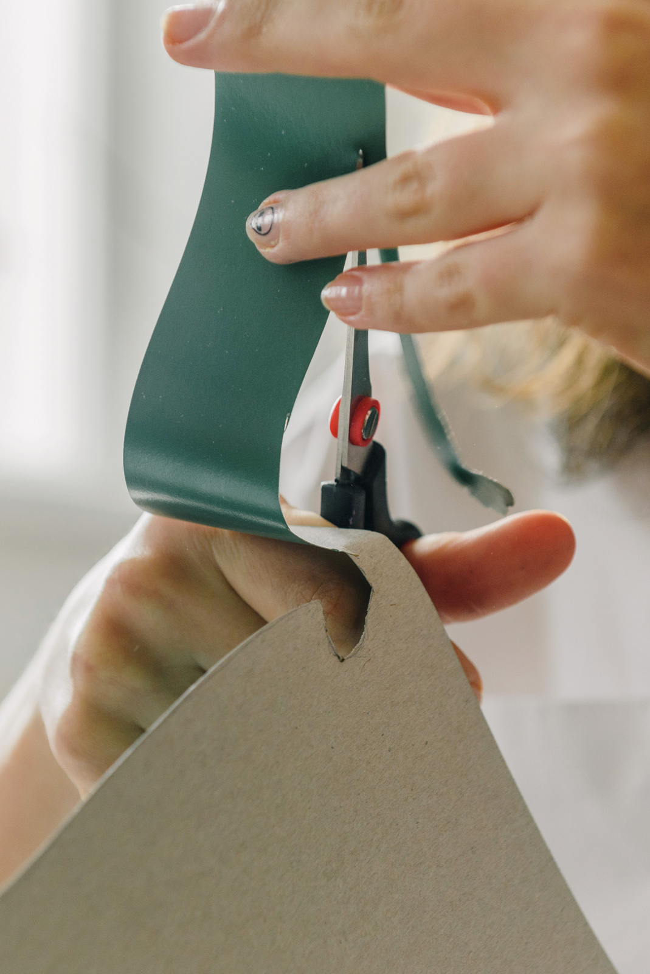
Larissa
Introduction
Start inspired with thousands of templates, collaborate with ease, and engage your audience with a memorable Canva Presentation.
Apply page animations and transitions to your Canva Presentation to emphasize ideas and make them even more memorable.

Slide 4

Tristan
Goals
Our First Goal
Our Second Goal
Our Third Goal
Pre-record your Canva presentation to present anytime, anywhere.
Add audio or record yourself talking over a presentation, then share it with everyone.
It’s excellent for capturing audiences beyond a one-time event.

Slide 5

Larissa
Background
General Overview
Present with ease and wow any audience with Canva Presentations. Choose from over a thousand templates to fit any objective or topic.
History
With Canva Presentations, you can collaborate in real-time with your teammates or co-presenters. Share tasks and work simultaneously to create a powerful presentation.

Slide 6
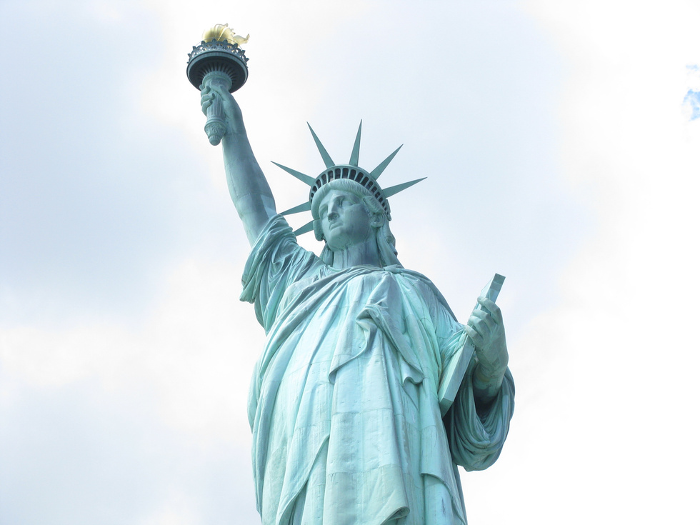
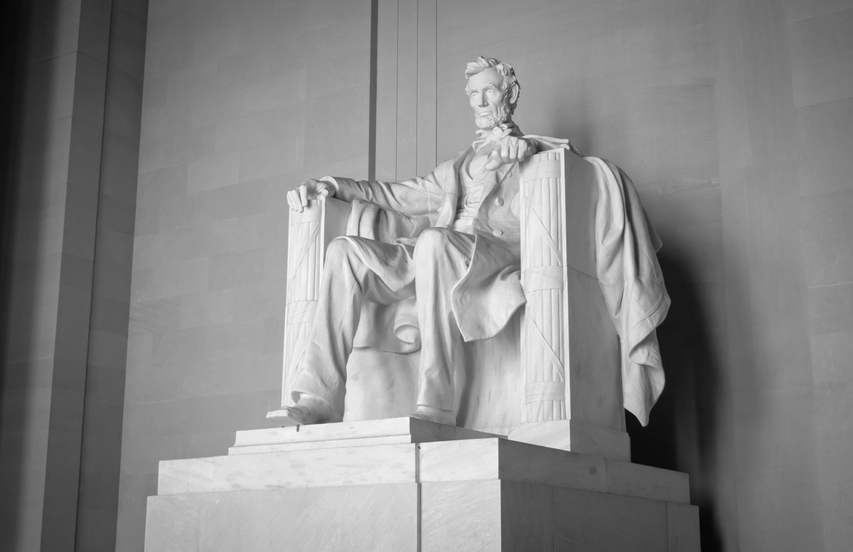
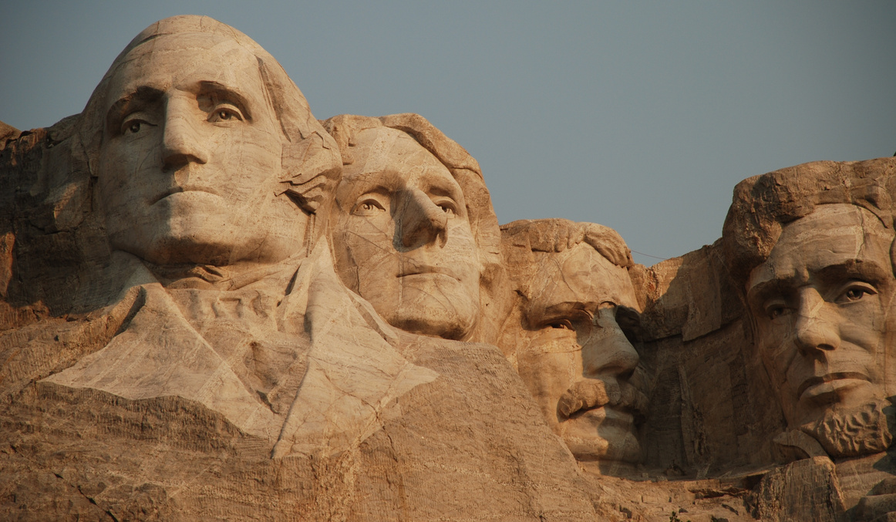
Notable People and Contributions
Larissa
Name and their Contribution
Apply page animations and transitions to your Canva presentation to emphasize ideas and make them even more memorable.
Name and their Contribution
Find the magic and fun in presenting with Canva Presentations by pressing C for confetti, D for a drumroll, and O for bubbles.
Name and their Contribution
Collaborate in real-time with your teammates. Share tasks and work simultaneously to create a powerful presentation.

Slide 7
Notable People and Contributions
Larissa
Name and their Contribution
Apply page animations and transitions to your Canva presentation to emphasize ideas and make them even more memorable.
Name and their Contribution
Find the magic and fun in presenting with Canva Presentations by pressing C for confetti, D for a drumroll, and O for bubbles.
Name and their Contribution
Collaborate in real-time with your teammates. Share tasks and work simultaneously to create a powerful presentation.

Slide 8

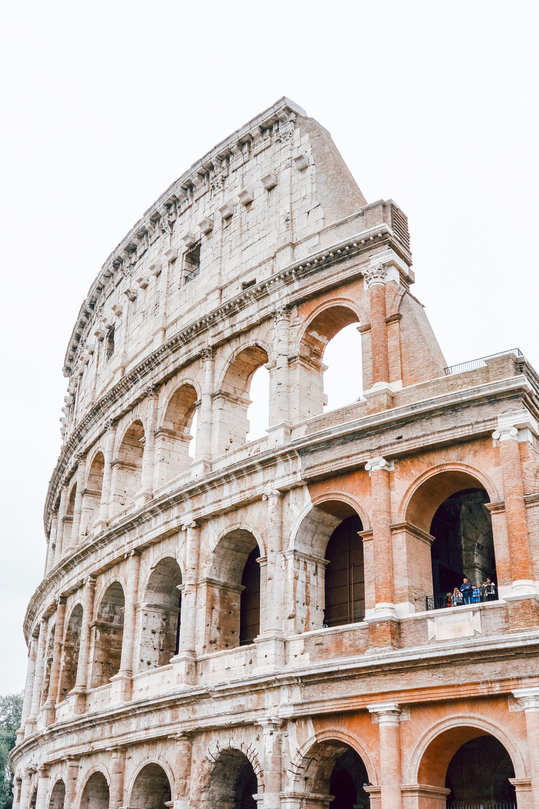
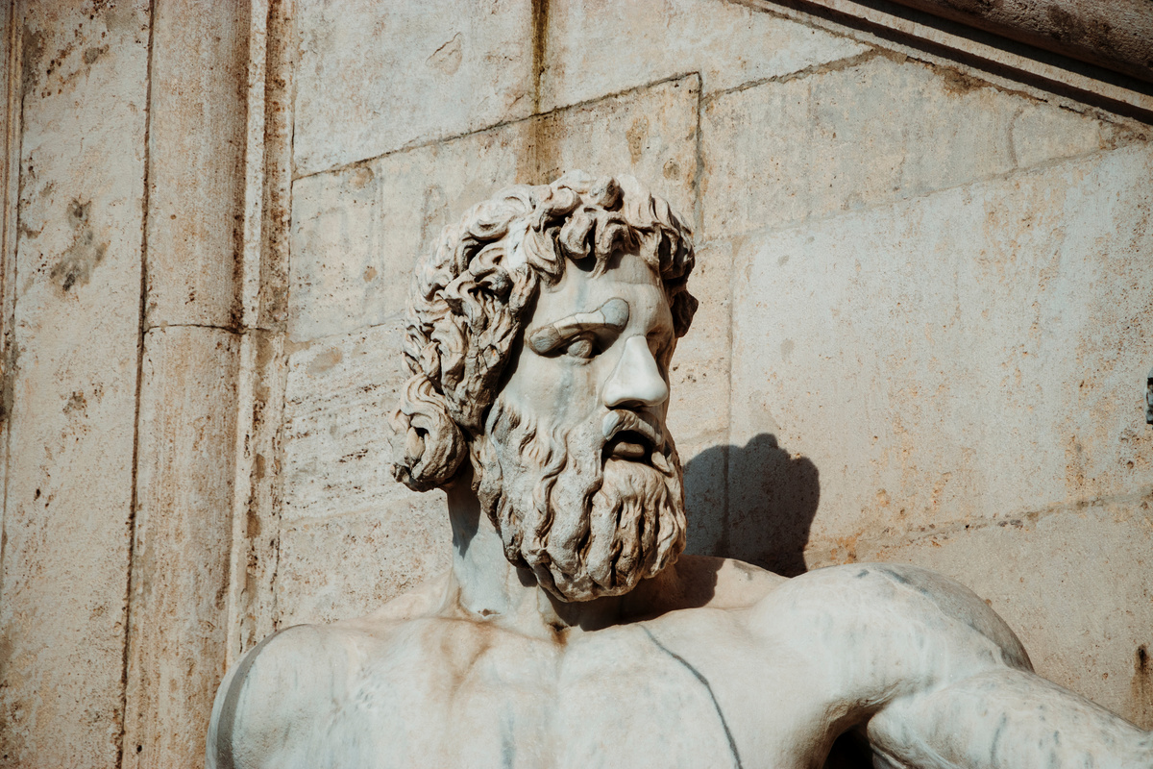

Sebastian
Main Concepts
The First Concept
The Second Concept
The Third Concept
Add audio or record yourself talking over a presentation, then share your video with everyone.
Pre-record your Canva presentation to present anytime, anywhere.
It’s excellent for capturing audiences beyond
a one-time event.

Slide 9



Larissa
Group Synthesis
Our First Synthesis
Our Second Synthesis
Our Third Synthesis
Wow any audience with your Canva presentation. Design, plan, and present all in one place.
Wow any audience with your Canva presentation. Design, plan, and present all in one place.
Wow any audience with your Canva presentation. Design, plan, and present all in one place.

Slide 10
Thank
You!
Do you have any questions for us?

